Slide 1
Oligopoly
Notes:
1

Slide 2
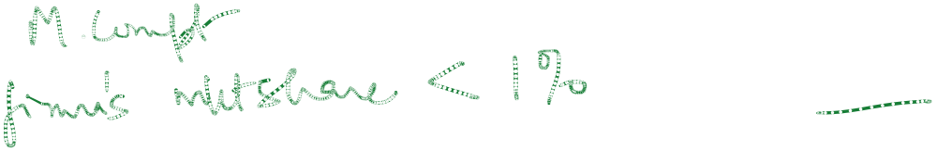

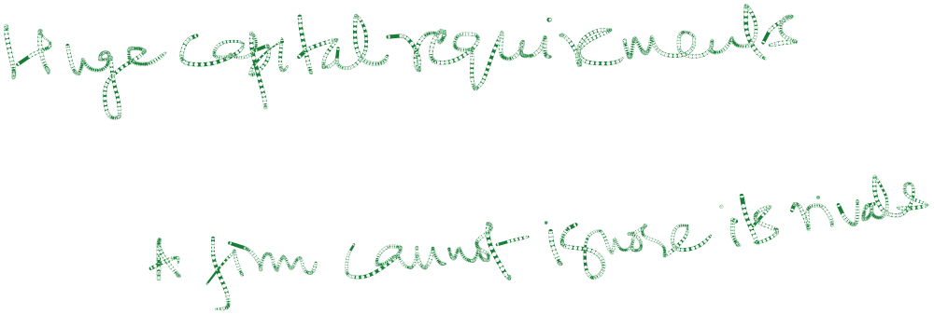
Oligopoly
Characteristics
  A few large producers
  * small number of large firms with big market shares.
  Product differentiation may or may not exist
  * homogenous or differentiated products.
  Barriers to entry
  Interdependent firm behaviour
  * strategic behaviour.
Notes:
24

Slide 3
Oligopoly
Examples
  Automobiles
  Steel
  Aluminum
  TV, WMs
  Computers
  Telecom
  Cement
  Softdrinks
Notes:
25

Slide 4
Oligopoly
Management Challenges
  Strategic actions
  Rival behavior
  Strategic Interactions
  To find the best managerial decision the manager of an oligopolistic supplier needs to think about the competitors reactions if :
  He changes the price
  He changes the production level
  He introduces a new product
  He changes the advertisement budget.
Notes:
28

Slide 5
Oligopoly
Equilibrium in an Oligopolistic Market
  In perfect competition, monopoly, and monopolistic competition the producers did not have to consider a rival’s response when choosing output and price.
  In oligopoly the producers must consider the response of competitors when choosing output and price. If they do not do so they will lose out.
Notes:
29

Slide 6


Oligopoly
Equilibrium in an Oligopolistic Market
  Defining Equilibrium
    Firms doing the best they can and have no incentive to change their output or price
    All firms assume competitors are taking rival decisions into account.
Notes:
30

Slide 7




Oligopoly
The ways in which rivals in oligopoly markets react to each other can be very many. Hence we do not have a single theory for oligopoly market structures unlike other market structures.
Oligopolies are diversified, complex but very relevant.
Notes:
31

Slide 8
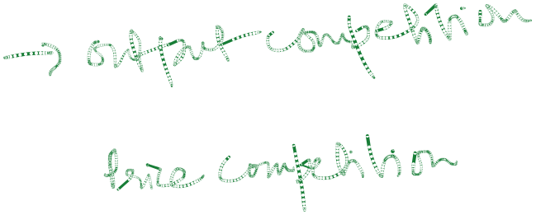







Oligopoly
Key feature of oligopoly
- interdependence of firms
Initial Models
- Cournot
- Bertrand
- Edgeworth
Competition versus collusion
Collusive oligopoly:
- Overt collusion – Cartels
- Tacit collusion – Price leadership
- Kinked Demand – Price stickiness
Non collusive oligopoly:game theory–price wars

Slide 9

Oligopoly Models
Factors favouring collusion
  Few firms
  Open with each other
  Similar production methods and average costs
  Similar products
  Significant entry barriers
  Stable market
  Overt collusion
  A cartel acts like a profit maximising multi-plant monopoly.

Slide 10
Profit-maximising cartel
Rs
Industry D = AR
O
Q
fig

Slide 11



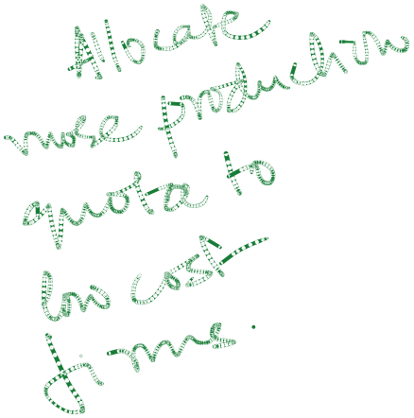



Profit-maximising cartel
Rs
Industry MC
The cartel output Q₁ is
allocated among mem-
ber firms or countries
according to multiplant
monopoly principle :
MR = MC₁ = MC₂
P₁
Industry D = AR
Industry MR
O
Q₁
Q
fig

Slide 12
Multiplant Monopoly
The Multiplant Firm
  For many firms, production takes place in two or more different plants whose operating cost can differ.
Notes:
3

Slide 13

Multiplant Monopoly
The Multiplant Firm
  Choosing total output and the output for each plant:
    The marginal cost in each plant should be equal.
    The marginal cost for each plant should equal the marginal revenue.
Notes:
3

Slide 14
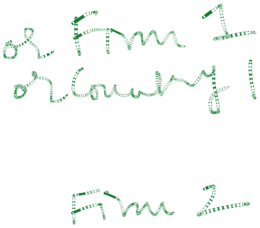
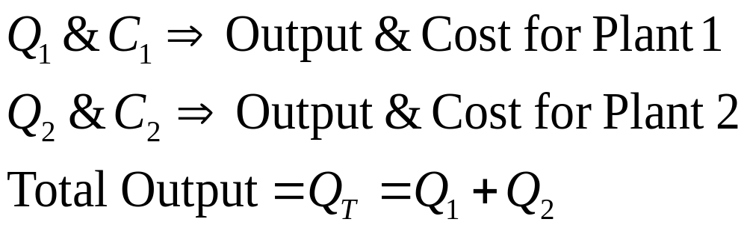
Multiplant Monopoly
The Multiplant Firm
Algebraically:
Notes:
3

Slide 15
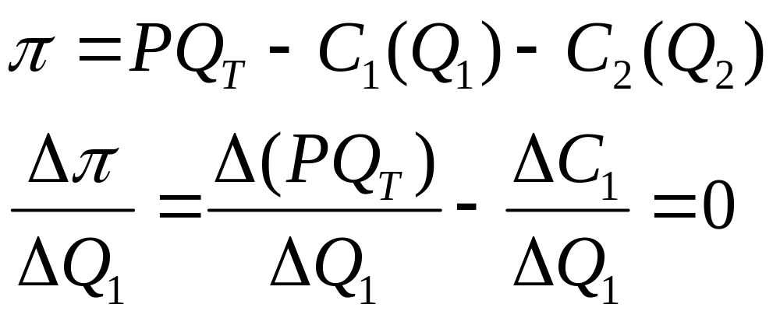

Multiplant Monopoly
The Multiplant Firm
Algebraically:
Notes:
3

Slide 16
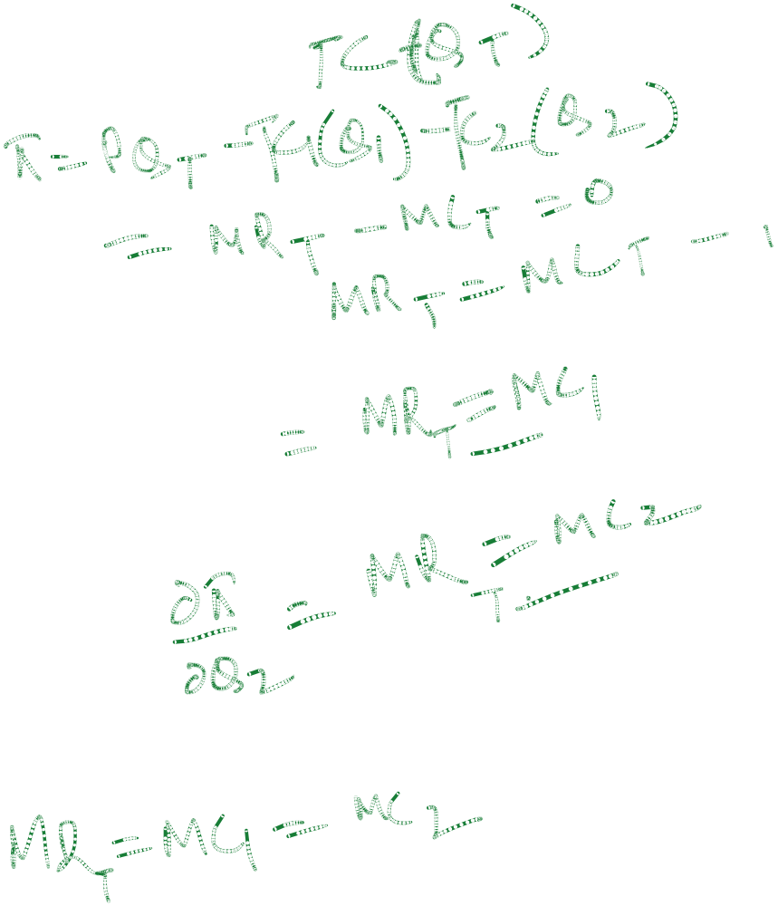

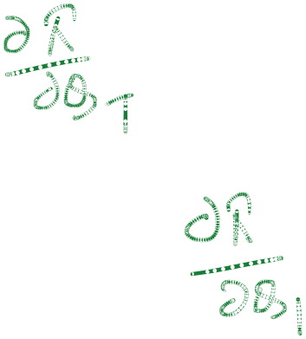


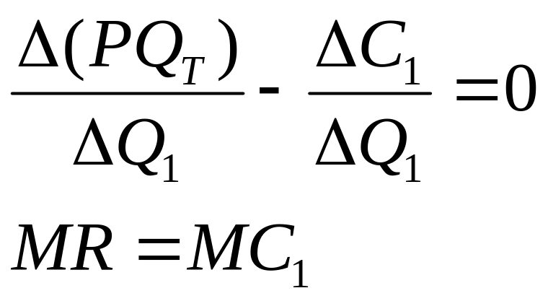
Multiplant Monopoly
The Multiplant Firm
Algebraically:
Notes:
3

Slide 17
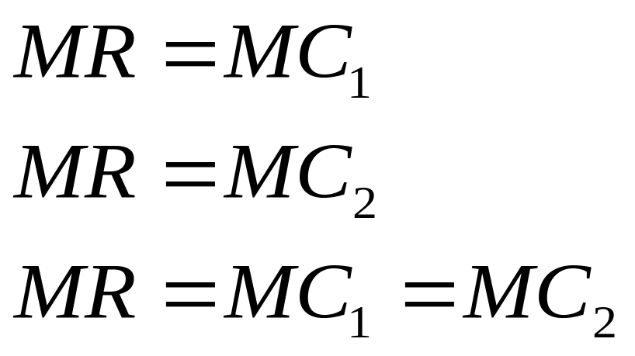
Multiplant Monopoly
Algebraically:
Notes:
3

Slide 18



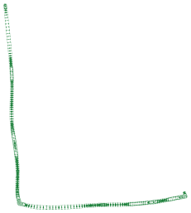

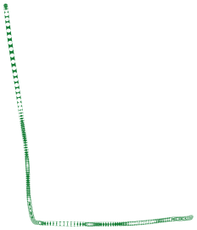










Production With Two Plants
Rs/Q
MC₁
MC₂
MC_{T}
P*
MR*
D = AR
MR
Q₁
Q₂
QT
Quantity

Slide 19















Production With Two Plants
Observations:
1) MC_{T} = MC₁ + MC₂
2) Profit maximizing output:
    MC_{T} = MR at Q_{T} and P *
    MR = MR*
    MR* = MC₁ at Q₁, MR* = MC₂ at Q₂
    MC₁ + MC₂ = MC_{T}, Q₁ + Q₂ = Q_{T,} and MR = MC₁= MC₂
Rs/Q
MC₁
MC₂
MC_{T}
P*
MR*
D = AR
MR
Q₁
Q₂
Q_{T}
Quantity

Slide 20


Cartels
Characteristics
1) Explicit agreements to set output and price
2) Example : OPEC, cement, automobile, tyre, zinc carbon battery etc.
Notes:
116

Slide 21



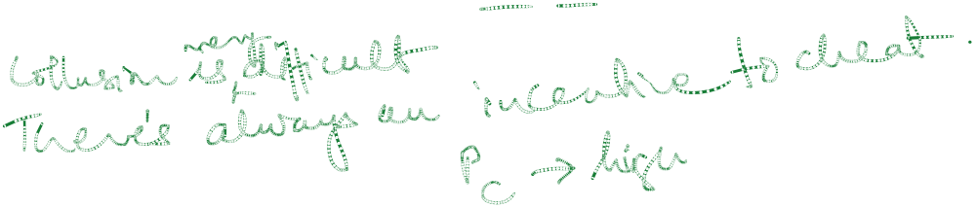
Cartels
Observations
  To be successful:
    Total demand must not be very price elastic
    Either the cartel must control nearly all of the world’s/nation’s supply or the supply of noncartel producers must not be price elastic.
Notes:
131

Slide 22




The Kinked Demand Curve Model Of Sweezy
There are few suppliers.
Output is differentiated/homogenous.
Each supplier believes that competitors will follow price decreases, but not price increases.
There are barriers to entry.

Slide 23
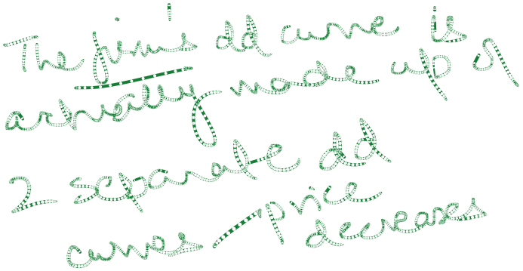
















The Kinked Demand Curve
Rs/Q
If the producer raises price the
competitors will not and the
demand will be elastic.
If the producer lowers price the
competitors will follow and the
demand will be inelastic.
D’
MR’
D
Quantity
MR
Notes:
109

Slide 24




The Kinked Demand Curve
Rs/Q
So long as marginal cost is in the
vertical region of the marginal
revenue curve, price and output
will remain constant.
MC’
P*
MC
D
Q*
Quantity
MR
Notes:
109

Slide 25
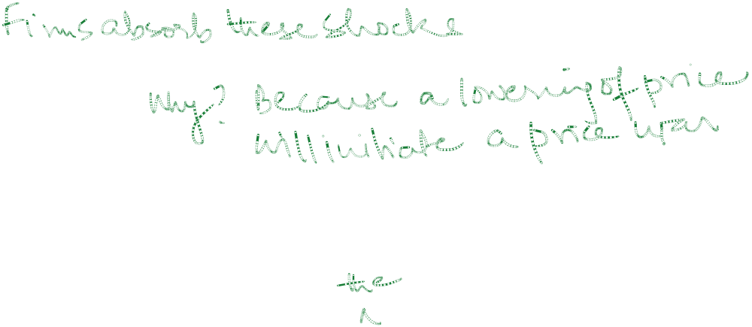
Conclusions From Sweezy Model
The price and output levels are insensitive to bounded changes on costs.
Firms believe in price rigidity.
Mature industry.
Firms recognise interdependence but act without collusion in keeping prices constant even in face of changing cost conditions (within a limit).
Examples – Rs 10 potato chips, Maggi/Top Ramen noodles, kitkat, perk, munch; marie biscuits, glucose biscuits etc.

Slide 26

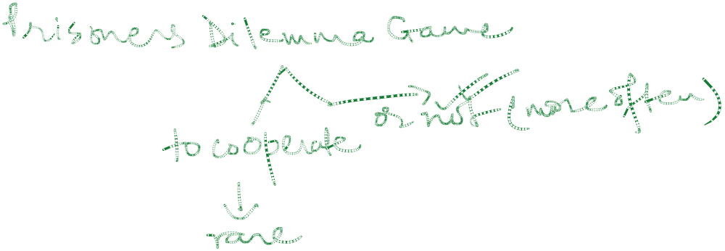
Oligopoly Models
The breakdown of collusion
Non-collusive oligopoly: game theory
  simple dominant strategy games

Slide 27

GAME THEORY FOR COMPETITIVE STRATEGIES
Developed by mathematician John V Neumann and economist Oskar Morgenstern in 1944.
Deals with the choice of best strategy in conflict situations.
For each strategy adopted by a player (firm), there is usually a number of strategies available to a rival player (firm).
Payoff is the outcome of each strategy expressed in terms of profits or losses of the firms.

Slide 28


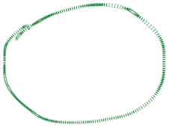




EXAMPLE 1
Dominant Strategy For Firm A and Firm B Exists
Payoff Matrix For An Advertising Game
-----------------------------------------------------------------------------------------------------------
Firm B
Advertise Don’t Advertise
Advertise (4, 3) (5, 1)
Firm A
Don’t Advertise (2, 5) (3, 2)
-----------------------------------------------------------------------------------------------------------
Dominant strategy for firm A is to advertise (columns).
Dominant strategy for firm B is also to advertise (rows).
Dominant strategy is the optimal choice for a player no matter what the opponent does. In such a game the best strategies are the same regardless of whether the players choose their strategies simultaneously or whether one or the other player goes first.

Slide 29


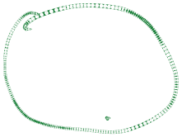
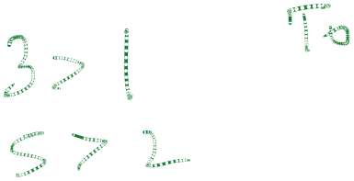




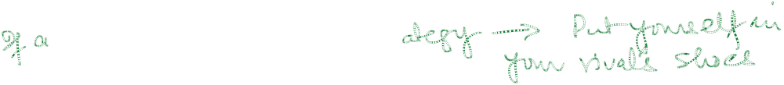

EXAMPLE 2
Dominant Strategy For Firm B Only
Payoff Matrix For An Advertising Game
-----------------------------------------------------------------------------------------------------------
Firm B
Advertise Don’t Advertise
Advertise (4, 3) (5, 1)
Firm A
Don’t Advertise (2, 5) (6, 2)
----------------------------------------------------------------------------------------------------------
Firm A does not have a dominant strategy. Only Firm B has one.
Dominant strategy for Firm B is to advertise.
The optimal strategy for Firm A is to advertise if firm B advertises and not to advertise if Firm B does not advertise.
That is, Firm A must determine what strategy firm B is going to adopt.
Since dominant strategy for Firm B is to advertise, the optimal strategy for Firm A is also to advertise.

Slide 30


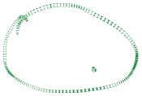
NASH EQUILIBRIUM
Nash equilibrium is the situation where each player chooses his optimal strategy, given the strategy chosen by the other player.
If each player has a dominant strategy, this strategy is its best choice regardless of what other players do.
Some games do not have a Nash equilibrium, also it is possible for some games to have more than one Nash equilibrium.
Payoff Matrix For An Advertising Game
-----------------------------------------------------------------------------------------------------------
Firm B
Advertise Don’t Advertise
Advertise (3, 3) (1, 1)
Firm A
Don’t Advertise (1, 1) (3, 3)
-----------------------------------------------------------------------------------------------------------
Two Nash equilibria

Slide 31

PRISONERS’ DILEMMA GAME
Game provides insight into the difficulty in maintaining cooperation.
Often firms fail to cooperate with one another even when cooperation would make them better off.
The Prisoners’ Dilemma is a “game” between two captured prisoners that illustrates why cooperation is difficult to maintain even when it is mutually beneficial.

Slide 32


PRISONERS’ DILEMMA GAME (Contd.)
Two suspects (A and B) are arrested for armed robbery.
If convicted, each could receive a maximum sentence of 10 years imprisonment.
However, unless one or both suspects confess, they could be convicted only of possessing stolen goods, which carries a maximum sentence of one year in jail.
Each suspect is interrogated separately.
If only one suspect confesses, he will go free while the other will receive full 10 year sentence.
If both confess, each gets a reduced sentence of 5 years.
Dominant strategy for both A and B is to confess. However, both would be better off if they cooperated and did not confess.

Slide 33


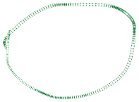



PRISONERS’ DILEMMA GAME
It refers to a situation in which each firm adopts its dominant strategy but each could do better by cooperating
Negative Payoff Matrix (Years of Detention)
For Suspect A and Suspect B
-----------------------------------------------------------------------------------------------------------
Individual B
Confess Don’t Confess
Confess (5, 5) (0, 10)
Individual A
Don’t Confess (10, 0) (1, 1)
-----------------------------------------------------------------------------------------------------------

Slide 34
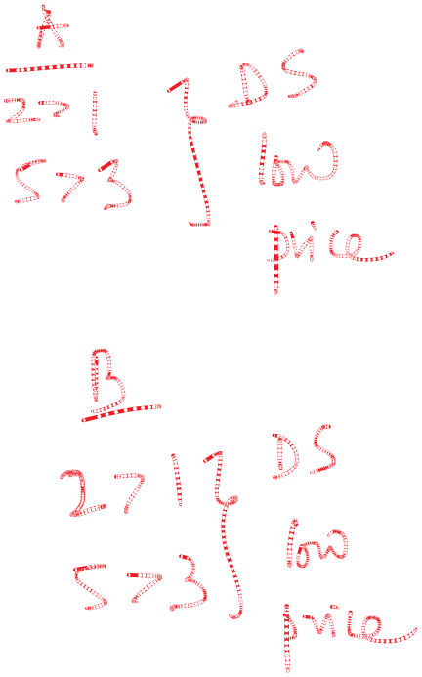
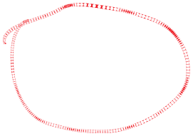
APPLICATION OF PRISONERS’ DILEMMA CONCEPT IN STRATEGIC DECISION MAKING
Payoff Matrix For A Pricing Game
-----------------------------------------------------------------------------------------------------------
Firm B
Low Price High Price
Low Price (2, 2) (5, 1)
Firm A
High Price (1, 5) (3, 3)
-----------------------------------------------------------------------------------------------------------
Payoff are profits for Firm A and Firm B.
Dominant strategy for A as well as for Firm B is to charge a low price, no matter what the other firm does.
Thus, A and B would adopt their dominant strategy of charging a low price and earn profits of (2, 2).
However, both firms could do better and earn higher profits of (3, 3) if they cooperated and both charged the high price. That is, A and B are in prisoners’ dilemma.
Each firm will charge the low price and earn a smaller profit because if it charges the high price, it cannot trust its rival to also charge the high price.

Slide 35

REPEATED GAMES AND TIT FOR TAT
In games involving many consecutive moves and counter moves by each player, the best strategy for each player is tit-for-tat for each player over time.
This strategy is retaliatory enough to discourage non-cooperation to develop.

Slide 36
Evaluation Of Oligopoly
Just like monopolistic competition, in Oligopoly too, price is higher and output is lesser than in a perfectly competitive market. That is, there is dead weight loss under Oligopoly.
There is excess capacity in Oligopoly too just like in Monopolistic competition.
Profits are made even in long run.
In both Monopolistic Competition and Oligopoly there is wastage of resources through selling activities.
However, consumer gains satisfaction from the wider range of products available. As in monopoly, the existence of profits provide a major incentive for inventions and innovations under Oligopoly (the process of creative destruction).

Slide 37
Homer's boat manufacturing has some monopoly power on boat sales in the region. Homer's marginal cost of the 8th boat produced is $1,200. He produces only eight boats and can sell all boats for $1,500 each. The elasticity of demand at this price is -2. Is Homer maximizing profits?

Slide 38
Suppose that the demand function for price increases and for price cuts facing an oligopolist are, respectively,
Q = 60 – P and Q = 80 - 1 P
3 3
Suppose that the firm’s total cost function is :
TC = 100 + 20Q + 0.5Q²
a) Derive the marginal revenue, marginal cost and average total cost functions of the firm.
b) Calculate price, output, marginal cost, and total profits at the profit
maximizing activity level.
c) Within what range can the MC curve of the firm shift without inducing it to change its price and output?
d) Explain why the demand curve takes the shape as indicated above.

Slide 39
Suppose that Mumbai University wants to reduce the athletic department’s operating deficit and increase students’ attendance at home football games. To achieve these objectives, a new third degree price discrimination type of pricing structure for season football tickets is being considered. A market survey conducted by the college suggests the following market demand relations for two segments of the market - general public and students.
Public demand: P_{P} = 225 – 0.005Q_{P}
Students Demand: P_{S} = 125 – 0.00125Q_{S} where
P_{P} : price of public ticket in rupees; P_{S} : price of student ticket in rupees; Q_{P} : quantity of public tickets; Q_{S} : quantity of student tickets
During recent years, the football programme has run on an operating budget of Rs. 15 lakhs per year. This budget covers fixed salary, recruiting, insurance and facilities maintenance expenses. In addition to these fixed expenses, the University incurs variable ticket handling, facility cleaning, insurance and security costs of Rs25 per season ticket holder. The resulting total cost function is -
TC = 15,00,000 + 25Q where Q = Q_{S} + Q_{P}
a) Assuming that the university can discriminate between its two types of customers, calculate the profit maximizing prices (P_{S} and P_{P}), quantities (Q_{S} and Q_{P}) and total profits of the university.
b) Calculate point price elasticities for each customer type at the activity levels identified in (a). Are the differences in elasticities consistent with your recommended price differences in part (a)? Why or why not? Explain clearly.

